Slide 1
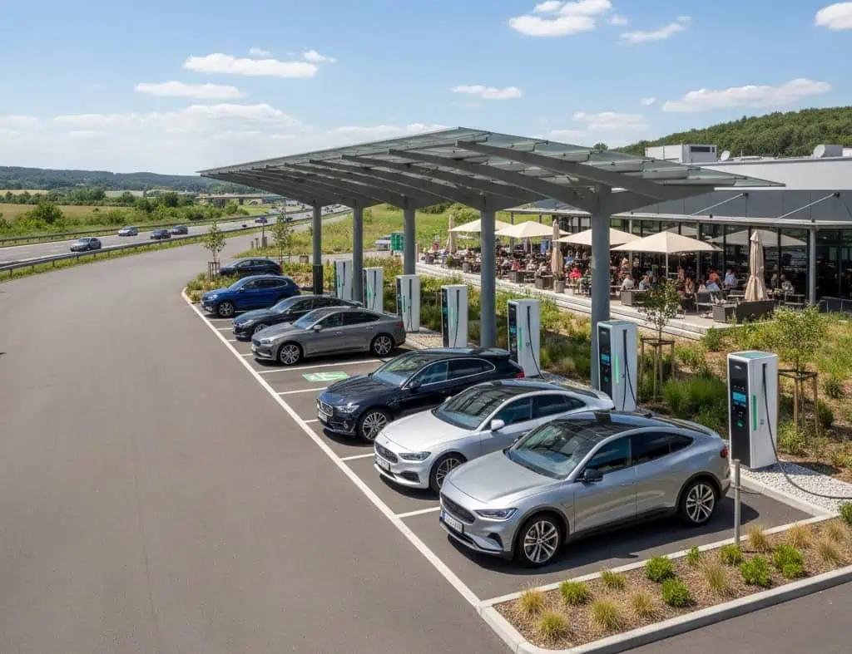
Roaming, Charging Challenges
And
Future Of Charging

Slide 2
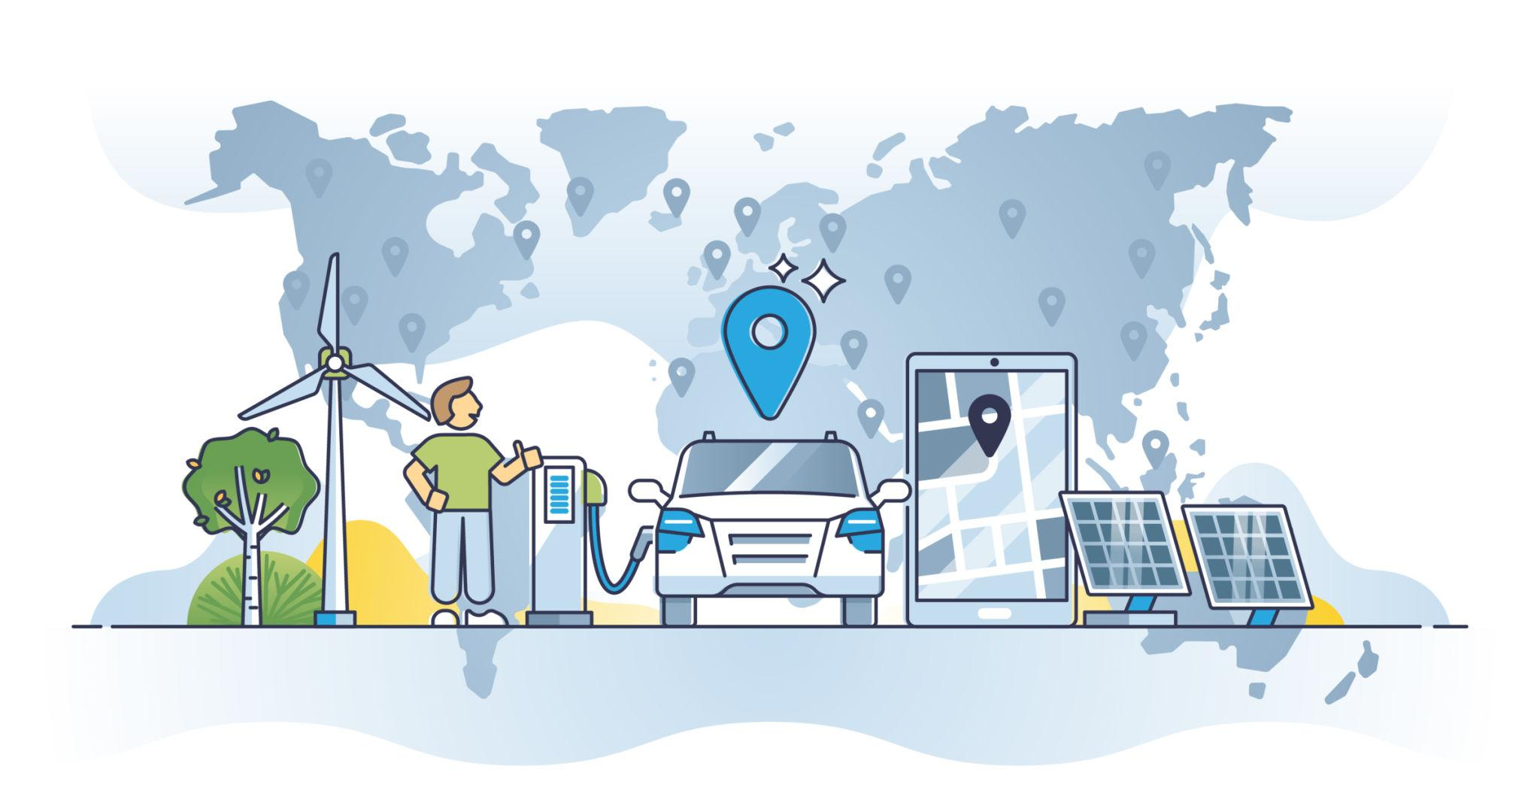
Understanding eRoaming
What is Roaming ?
Electric vehicle roaming allows drivers to charge their cars at any public station, regardless of the charging network provider, with a single account.
1. No Fragmentation : Eliminates the need for
multiple apps and cards.
2. Interoperability : ensures seamless network to
network service.
Why it is Vital ?
For the automotive industry, roaming is a key
driver of overall EV adoption rates, directly
tackling consumer charger anxiety.
1. Cross-Border : Crucical for long-distance
highway corridors.
2. Standardized Access: Lowers entry barriers
for new owners.

Slide 3
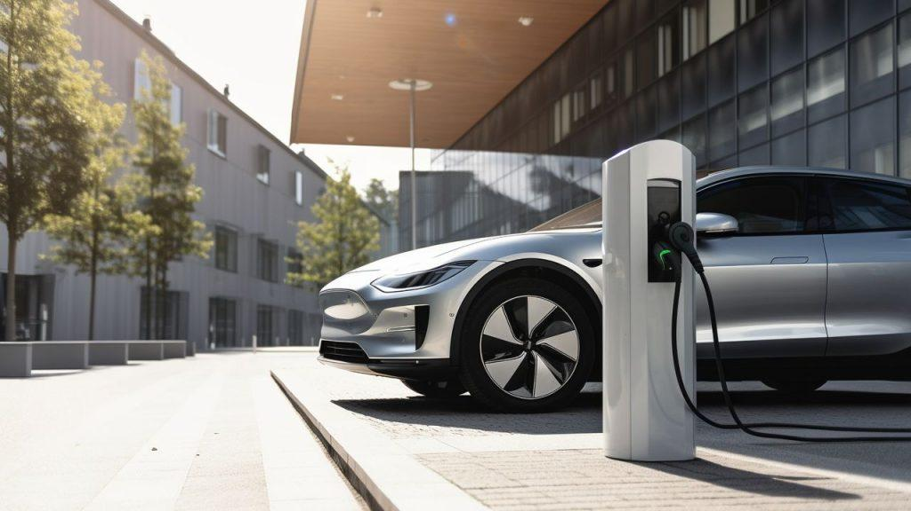
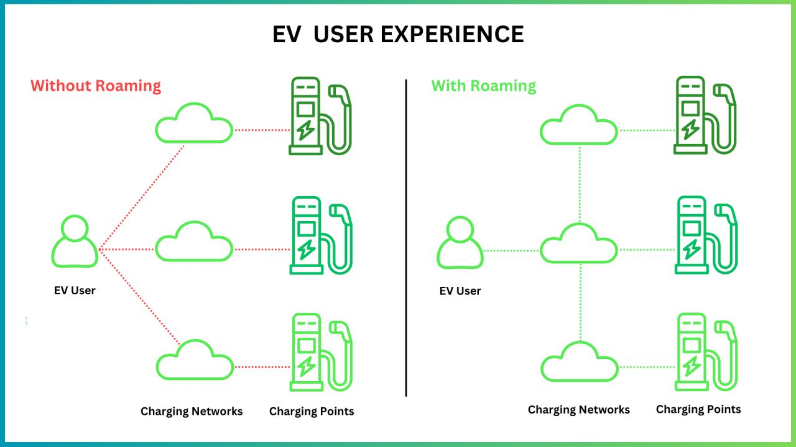
Roaming Architecture
The Three Main Stake Holders Work Together To Make Roaming Possible
Charging Point Operators : They manage and bulid the
Physical infrastructure : Hardware, maintenance, and power
flow from the grid to the port.
Responsibilities : 1.Installing Charging stations.
2.Ensure Chargers Function Properly.
3.Monitor energy consumption and
charging performance.
E-Mobility Providers : They manage customers interaction
like digital accounts, mapping apps, payments,billing, and
Customer support.
Roaming Hubs : They enable interoperability between
networks and exchange authentication and billing data also
ensure secure coomunication between parties. Reduce the
need for direct agreements between every CPO and eMSP.

Slide 4
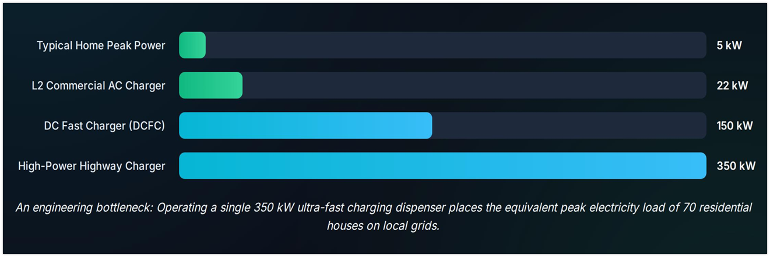
Grid Constraints & Architecture
Power & Grid Strain

Slide 5
AC Vs DC Architecture
Parameter | AC Charging (Level 1 & 2) | DC Fast Charging (DCFC)
Conversion Location | Converted on Board the vehicle (limited converter capacity). | Converted off-board in the charging station cabin.
Typical Power Outputs | 3KW to 22KW | 50KW to 350KW+
Grid Connection | Single or 3-phase Low Voltage (LV) network. | Direct Medium Voltage (MV) transformer required.
Primary use case | Overnight residential parking/Worplace lots. | Highway rest stops/Commercial Transit corridors.

Slide 6
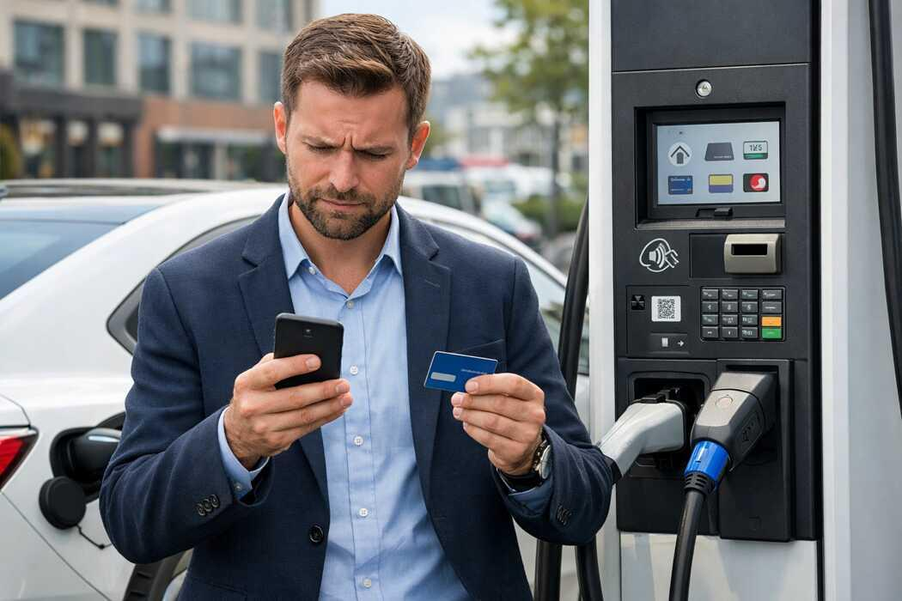
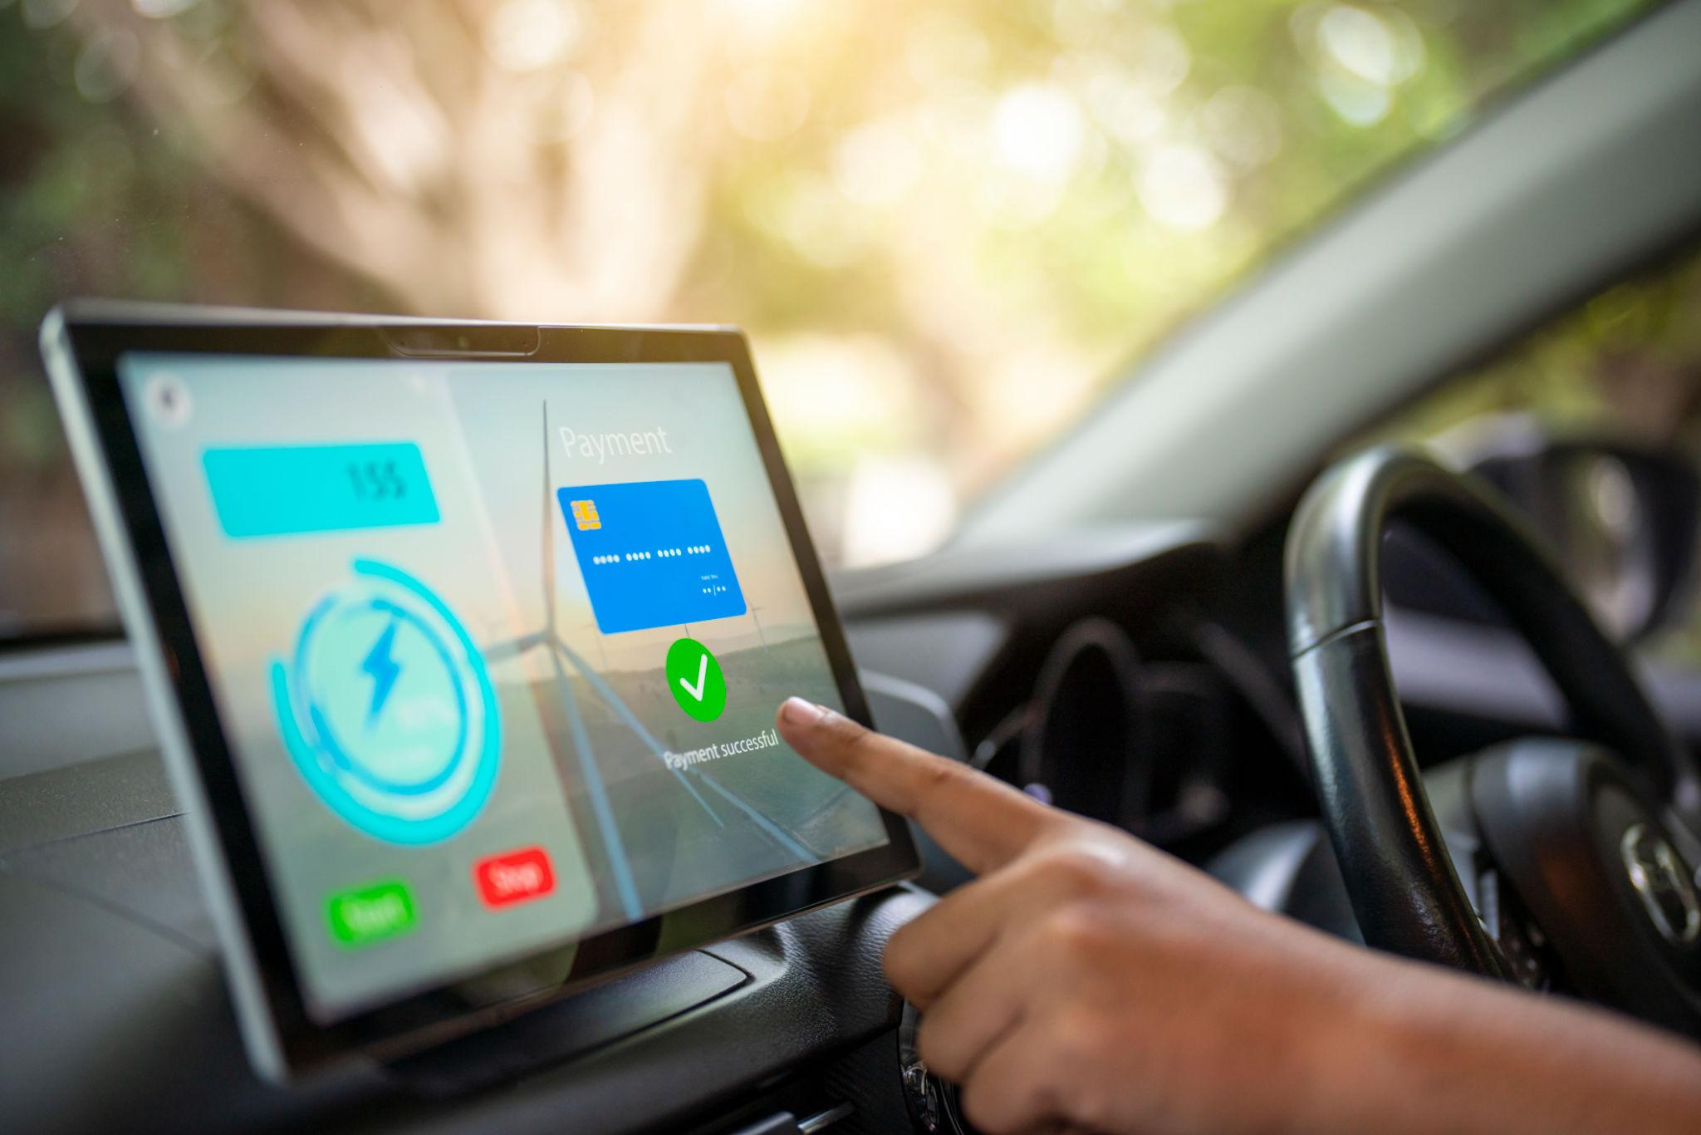
Consumer Pain Points
Payment Friction :EV drivers often face challenges when paying for charging services due to the lack of a unified payment system across charging networks. Many charging stations require users to download specific apps, create separate accounts, or obtain RFID cards before charging.
Price Ambiguity:Price ambiguity is a major challenge for EV users because charging costs are often unclear and vary significantly between charging networks.
Siloed Software:Siloed software refers to the lack of interoperability between different EV charging networks and service providers.

Slide 7
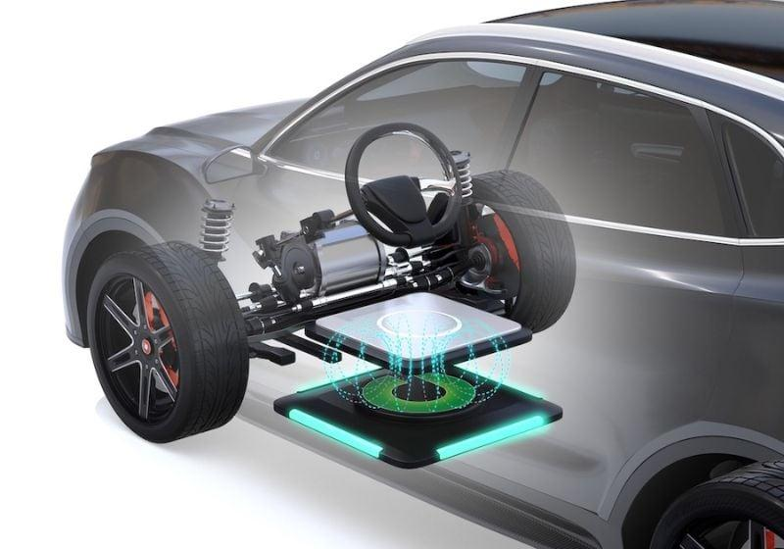
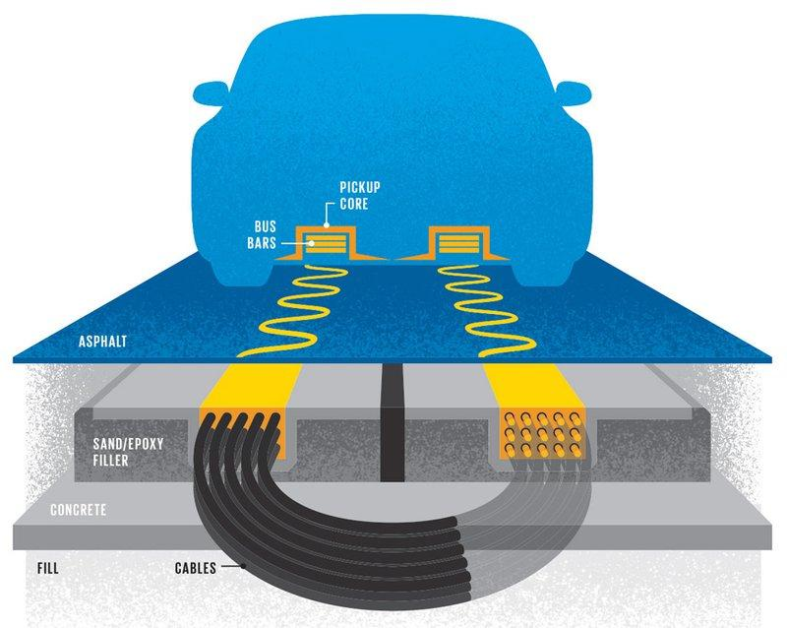
Wireless Tech Induction
Wireless Power Transfer : Under-road coils are embedded charging coils installed beneath the surface of roads or parking areas that transfer electrical energy wirelessly to electric vehicles through electromagnetic induction.
Fleet Integration : Fleet integration refers to the implementation of wireless charging systems within commercial vehicle fleets such as buses, taxis, delivery vans, and logistics vehicles.
Automotive Impact: Wireless Power Transfer has the potential to significantly transform the automotive industry by making EV charging more convenient, efficient, and seamless.

Slide 8
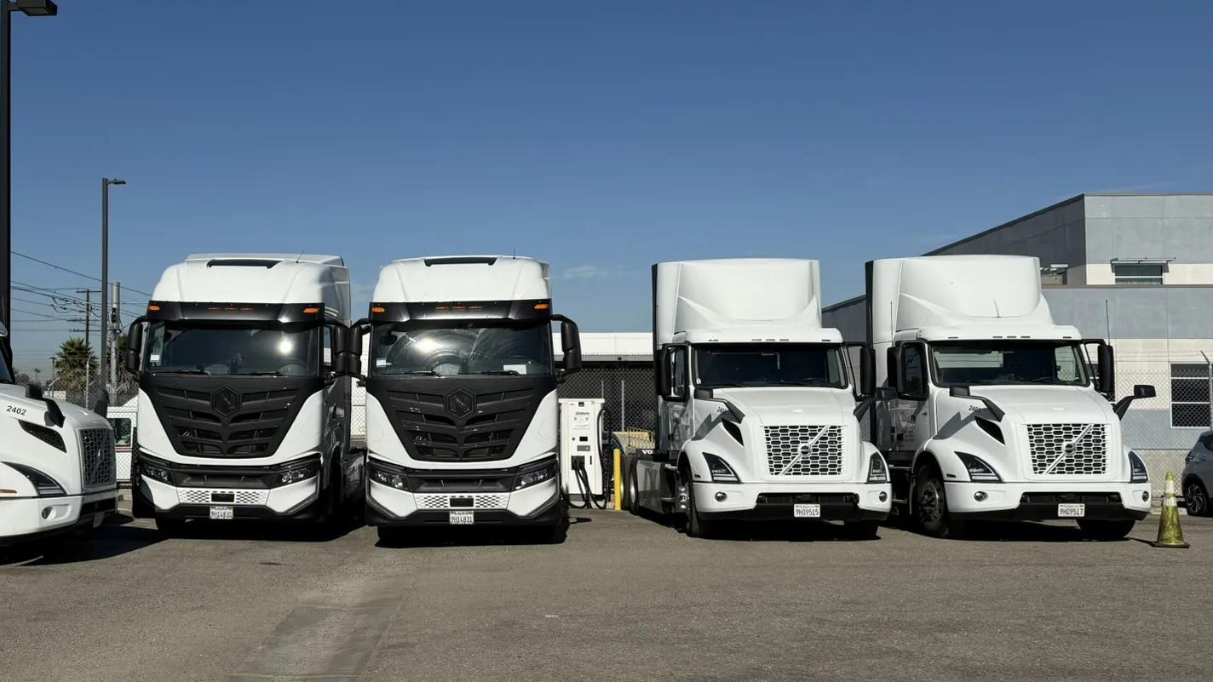
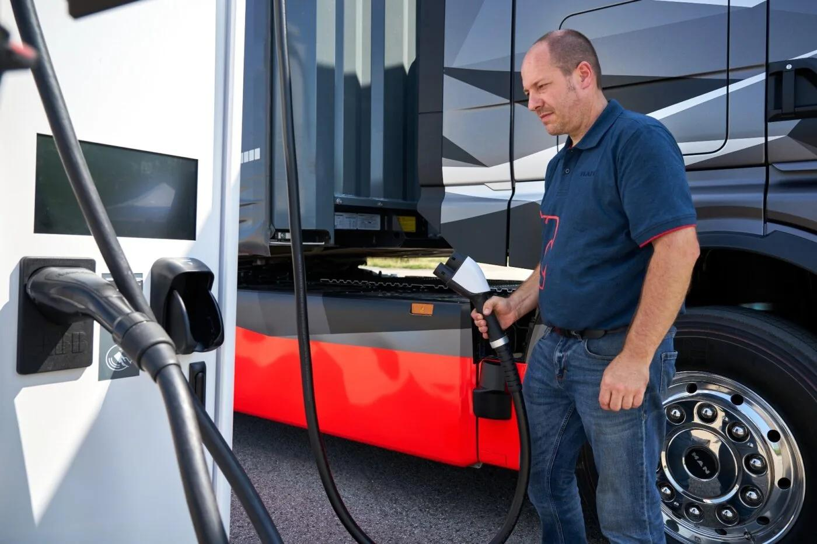
Megawatt Charging
Heavy duty Fleet Revolution : The Heavy-Duty Fleet Revolution refers to the transformation of commercial transportation through the adoption of high-power electric charging solutions for heavy trucks, buses, and marine freight vessels. Advanced charging technologies, such as Megawatt Charging Systems (MCS), are specifically designed to recharge large vehicles during legally required driver rest periods, minimizing downtime and improving operational efficiency. These systems can deliver extreme levels, reaching up to 3.75 MW at 1,250V and 3,000A, using liquid-cooled conductors and connectors to safely manage the immense electrical load.

Slide 9

Thank You

